Slide 1

FinAgent: Empowering Multi-Agent Stock Research and Recommendation System with AI
A Novel Multi-Agent System for In-Depth Stock Analysis and Recommendations.
Presented By:
Sachin Kumar
Jaspreet Singh Bhambra
Course: AI Agents

Slide 2
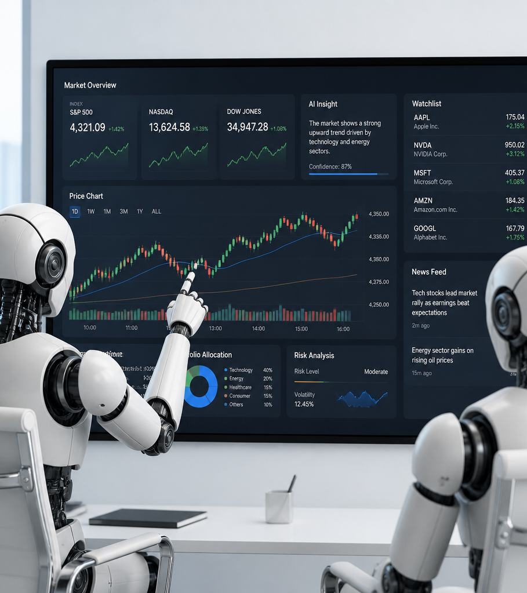
Develop a Sophisticated Multi-Agent AI System for Stock Analysis
Integrating diverse data sources like Yahoo Finance, NewsAPI, Alpha Vantage API, and Open AI, generating explainable reports, and providing actionable recommendations via an interactive dashboard.

Slide 3
Disclaimer
This project is for educational and research purposes only and does not constitute financial advice.
This disclaimer is integrated into the README, dashboard, and final reports.

Slide 4
Core: Multi-Agent Architecture
Specialized Agents for Stock Analysis
DATA COLLECTION AGENT
Gathers relevant market and company data.
FINANCIAL ANALYSIS AGENT
Analyzes financial statements and key ratios.
TECHNICAL ANALYSIS AGENT
Interprets chart patterns and trading indicators.
NEWS SENTIMENT AGENT
Assesses market sentiment from news and social media.
RISK ANALYSIS AGENT
Evaluates potential risks associated with investments.
DECISION AGENT
Synthesizes information to make informed investment decisions.
REPORT AGENT
Generates comprehensive analysis reports.

Slide 5
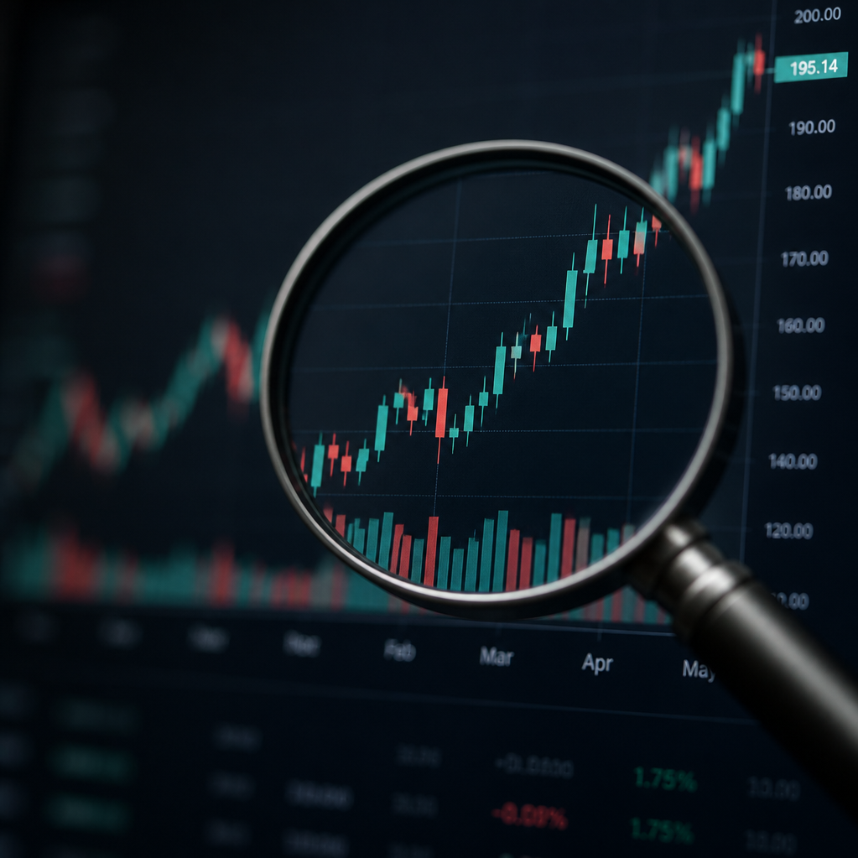
DATA ACQUISITION
Agent Deep Dive: Data Collection
Leverages the `yfinance` Python library to retrieve comprehensive stock market data.
KEY DATA POINTS:
Current and historical stock prices
Company financial information
Key statistics and fundamentals
ROBUSTNESS:
Implements error handling for invalid ticker symbols and missing data.
ENSURES A RELIABLE AND CLEAN DATA STREAM FOR DOWNSTREAM ANALYSIS, MODELING, AND DECISION-MAKING.

Slide 6

ANALYSIS OVERVIEW
Agent Deep Dive: Financial Analysis
This analysis leverages key fundamental data points to generate a comprehensive Financial Health Score, providing clear insights into an agent's fiscal standing.
CORE ANALYSIS PILLARS:
VALUATION: ASSESSES MARKET VALUE AGAINST FINANCIAL PERFORMANCE USING METRICS LIKE P/E RATIOS AND PRICE-TO-BOOK. AIMS TO DETERMINE IF THE AGENT'S PERCEIVED VALUE IS JUSTIFIED BY UNDERLYING FINANCIAL METRICS.
PROFITABILITY: EXAMINES REVENUE GENERATION EFFICIENCY THROUGH GROSS, OPERATING, AND NET PROFIT MARGINS, ALONG WITH RETURN ON EQUITY (ROE) AND ASSETS (ROA). HIGH AND CONSISTENT PROFITABILITY INDICATES STRONG OPERATIONAL PERFORMANCE.
GROWTH: TRACKS THE EXPANSION OF REVENUE, EARNINGS, AND CASH FLOW OVER TIME. SUSTAINABLE GROWTH IS A KEY INDICATOR OF MARKET COMPETITIVENESS AND FUTURE POTENTIAL.
DEBT: EVALUATES THE AGENT'S LEVERAGE AND ABILITY TO MEET FINANCIAL OBLIGATIONS USING RATIOS SUCH AS DEBT-TO-EQUITY AND INTEREST COVERAGE. MANAGES RISK BY ENSURING DEBT LEVELS ARE SUSTAINABLE.
FINANCIAL HEALTH SCORE (1-10): A SYNTHESIZED SCORE REFLECTING THE OVERALL FINANCIAL WELL-BEING OF THE AGENT, DERIVED FROM THE WEIGHTED ANALYSIS OF THE ABOVE PILLARS. CLEAR EXPLANATIONS: DETAILED COMMENTARY OUTLINING THE SPECIFIC FACTORS, BOTH POSITIVE AND NEGATIVE, THAT INFLUENCED THE FINAL SCORE, ENABLING TARGETED IMPROVEMENT STRATEGIES.

Slide 7
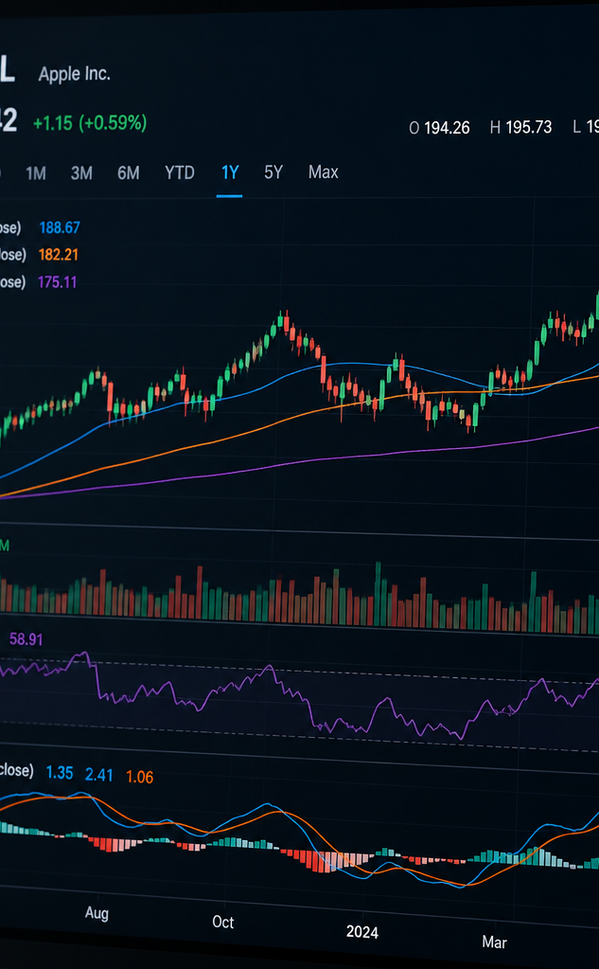
PROCESS OVERVIEW
Agent Deep Dive: Technical Analysis
Analyzes historical price data to calculate indicators (Moving Averages, RSI, etc.).
Generates a technical signal (Bullish, Neutral, Bearish) with reasoning.

Slide 8
Agent Deep Dive: News Sentiment
Performs sentiment analysis on news headlines to categorize sentiment as Positive, Neutral, or Negative. This agent can process sample data or integrate with an optional API for real-time analysis.

Slide 9





Agent Deep Dive: Risk Analysis
Identifying and evaluating potential risks
VOLATILITY
VALUATION
DEBT
NEGATIVE SENTIMENT
PRICE DROPS
Fluctuations in market price or performance.
Assessment of the asset's or company's current worth.
The level of financial obligation.
Public perception and market mood.
Significant decreases in value.
THE OUTPUT PROVIDES A CLEAR RISK LEVEL (LOW, MEDIUM, OR HIGH) ACCOMPANIED BY DETAILED JUSTIFICATIONS FOR THE ASSESSMENT.

Slide 10
DECISION MAKING AGENT
Agent Deep Dive: Decision Making
This agent synthesizes insights from all other agents to generate a final Buy, Hold, or Sell recommendation. It provides:
FINAL RECOMMENDATION: CLEAR BUY, HOLD, OR SELL DECISION.
CONFIDENCE SCORE: QUANTIFIES THE CERTAINTY OF THE RECOMMENDATION.
EXPLANATION: JUSTIFICATION AND REASONING BEHIND THE DECISION.

Slide 11
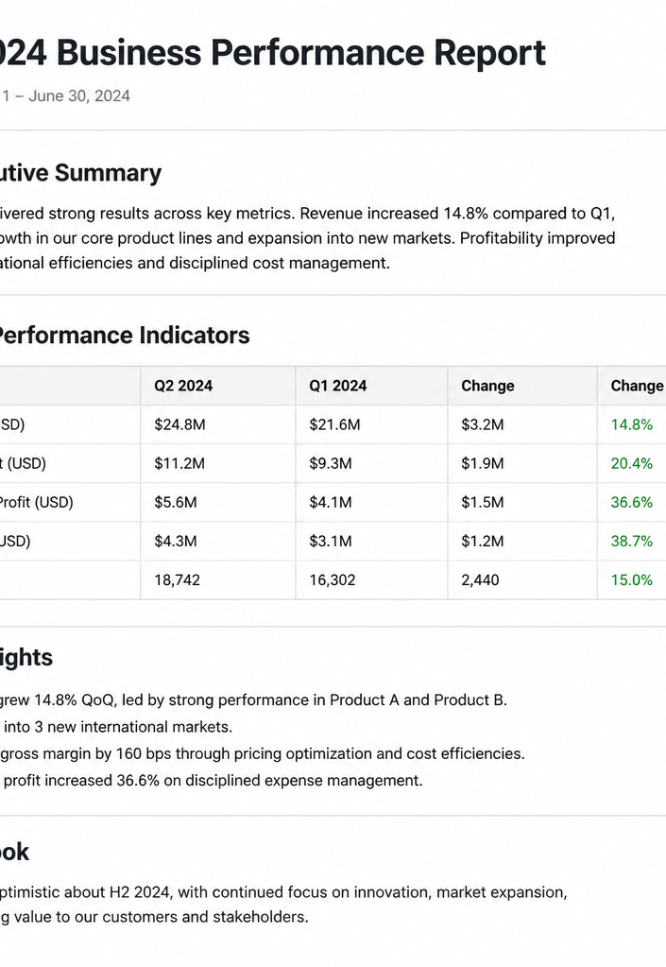
REPORT GENERATION PROCESS
Agent Deep Dive: Report Generation
Purpose: To synthesize all analyzed data into a comprehensive and easily understandable Markdown report.
Content: Includes a detailed compilation of key findings derived from the analysis.
Output: Delivers a final recommendation based on the compiled findings.
Format: Clean, explainable Markdown for clarity and accessibility.
FINAL RECOMMENDATION DELIVERED IN ACCESSIBLE MARKDOWN FORMAT.

Slide 12
Technical Requirements
CORE LANGUAGE
Python will serve as the primary programming language.
KEY LIBRARIES
A suite of essential libraries for data handling, analysis, and visualization.
YFINANCE
For fetching financial market data.
PANDAS
For efficient data manipulation and analysis.
NUMPY
For numerical computations and array operations.
MATPLOTLIB
For creating static, animated, and interactive visualizations.
TEXTBLOB / VADERSENTIMENT
For performing sentiment analysis on text data.
STREAMLIT
For building and deploying interactive web applications.
ARCHITECTURE
A modular design will be implemented to ensure maintainability and scalability.

Slide 13
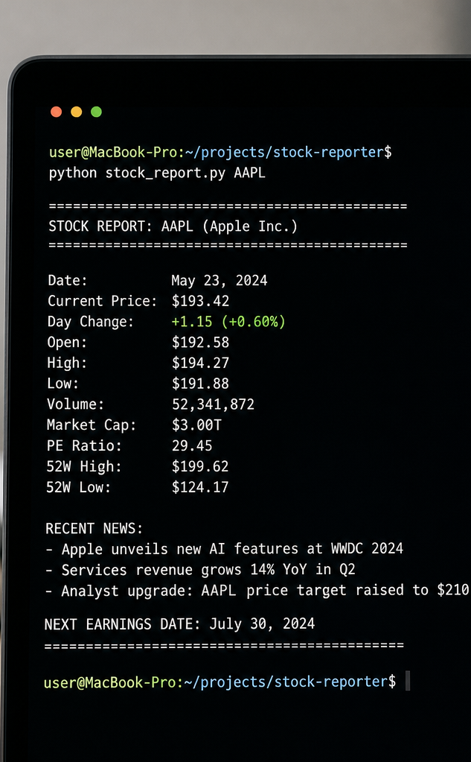
RUN ANALYSIS DIRECTLY FROM THE TERMINAL BY PROVIDING A STOCK TICKER.
Interface: Command Line
Command Example:
python main.py --ticker AAPL
Features:
DIRECT EXECUTION VIA TERMINAL.
SPECIFY STOCK TICKER AS AN ARGUMENT.
GENERATES AND SAVES A MARKDOWN REPORT.

Slide 14
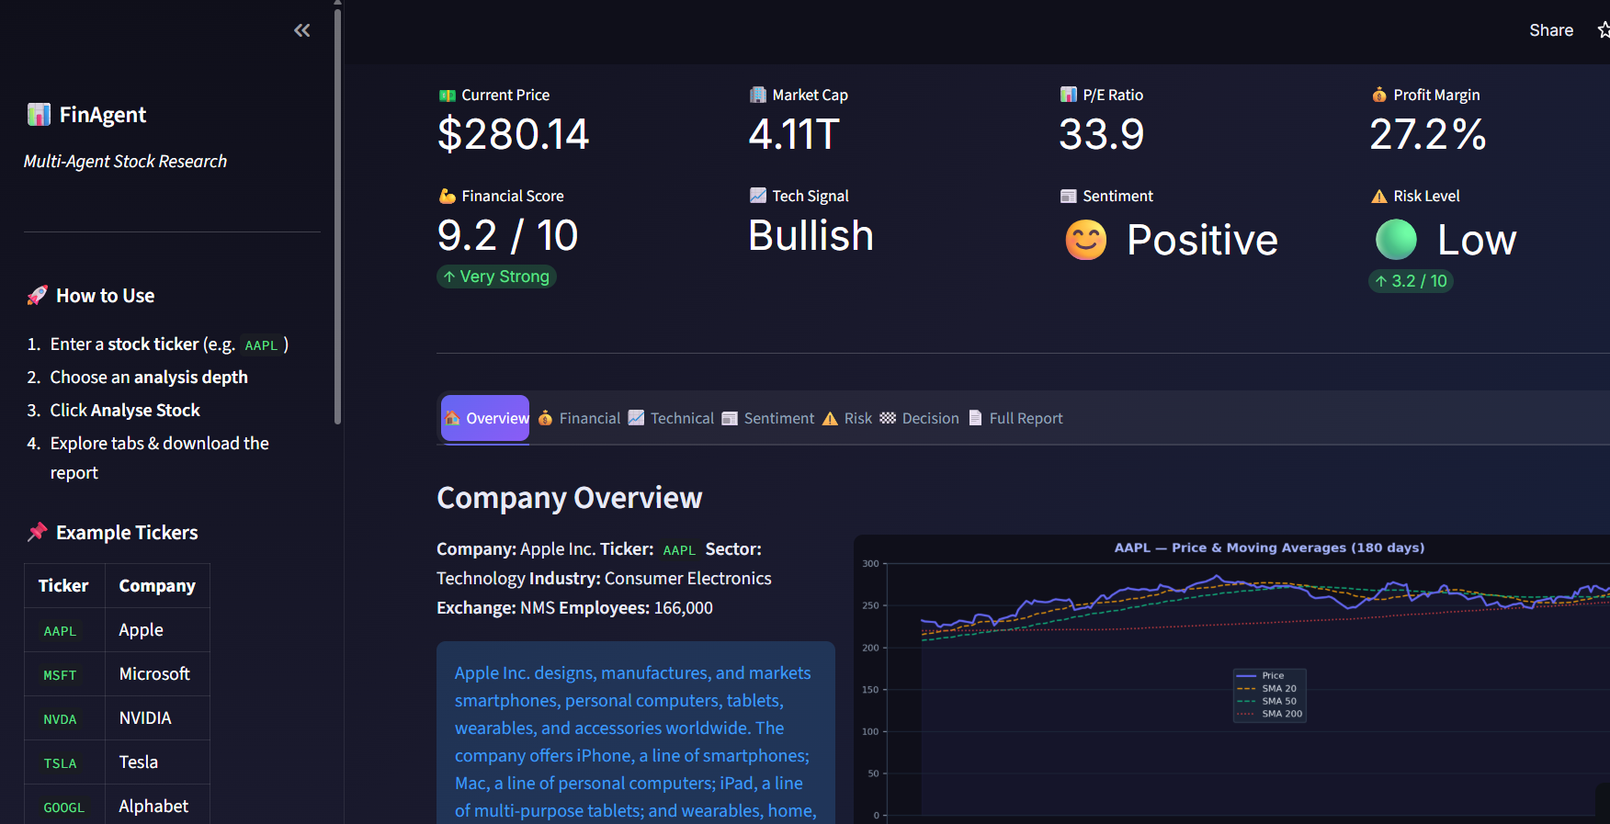
KEY FEATURES
Streamlit Web App: An Interactive Dashboard
Overview: A user-friendly dashboard designed for seamless interaction.
Technology: Built using Streamlit, a powerful Python library for rapid web app development.
User Experience: Features interactive elements to enhance usability and engagement.
Execution: Run locally with the command: streamlit run app.py

Slide 15
KEY COMPONENTS
Streamlit Dashboard - Landing Page
PROJECT TITLE & SUBTITLE: CLEARLY IDENTIFIES THE PROJECT.
EDUCATIONAL DISCLAIMER: PROVIDES IMPORTANT CONTEXT REGARDING THE DASHBOARD'S PURPOSE.
SIDEBAR: OFFERS INSTRUCTIONS AND PRACTICAL USAGE EXAMPLES FOR USERS.

Slide 16
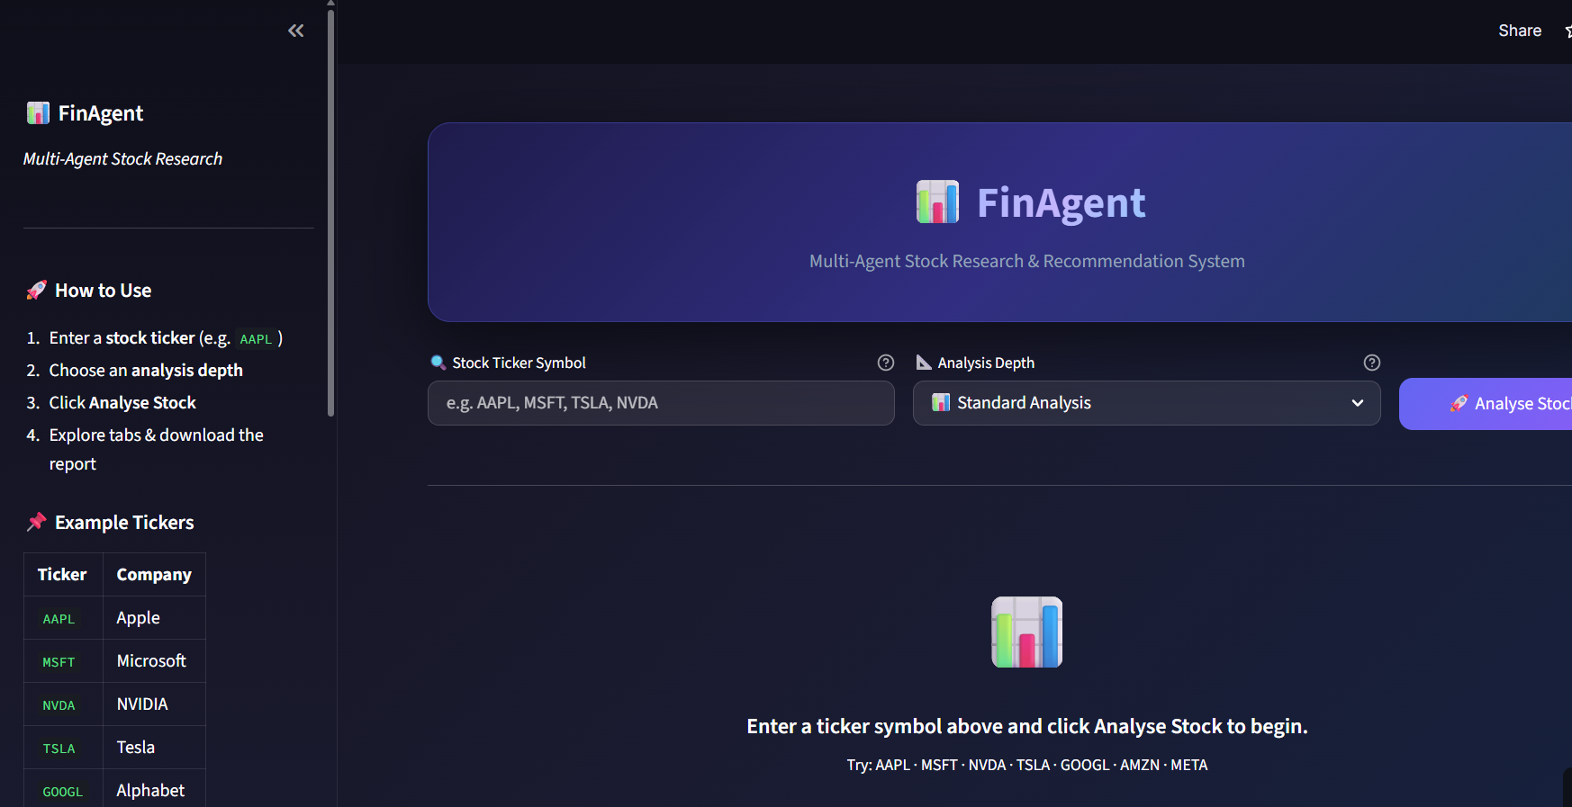
USER CONFIGURATION
Streamlit Dashboard - Input Section
This section allows users to configure stock analysis parameters:
TICKER INPUT: ENTER THE STOCK SYMBOL (E.G., AAPL, GOOGL).
ANALYSIS DEPTH: SELECT THE LEVEL OF DETAIL FOR THE ANALYSIS:
Quick
Standard
Detailed
ANALYZE STOCK BUTTON: INITIATES THE DATA RETRIEVAL AND ANALYSIS PROCESS.

Slide 17




Streamlit Dashboard - Visualizations
Key data presented through interactive charts
STOCK PRICE
MOVING AVERAGES
RELATIVE STRENGTH INDEX (RSI)
65
MOMENTUM
CONFIDENCE PROGRESS BAR
Risk Level Indicators
75%
CLEAR SIGNALS FOR ASSOCIATED RISKS.

Slide 18
Streamlit Dashboard - Organized Output
PRICE
SCORES
$1,234.56
8.5/10
MARKET CAP
$500B
DETAILED INFORMATION AND ANALYSES ARE NEATLY ORGANIZED INTO DISTINCT TABS FOR EASY NAVIGATION AND DEEPER UNDERSTANDING.

Slide 19
Streamlit Dashboard - Agent Tabs
Dedicated tabs for each agent's output
* **FINANCIAL**
* **TECHNICAL**
* **SENTIMENT**
INCLUDES AN **OVERVIEW** AND THE **FULL REPORT** FOR EASY NAVIGATION AND UNDERSTANDING.
* **RISK**
* **DECISION**

Slide 20
KEY ENHANCEMENTS FOR USABILITY:
Streamlit Dashboard: Elevating User Experience
LOADING SPINNERS: PROVIDE VISUAL FEEDBACK DURING DATA PROCESSING, MANAGING USER EXPECTATIONS AND REDUCING PERCEIVED WAIT TIMES.
INFORMATIVE MESSAGES: UTILIZE SUCCESS, WARNING, AND ERROR MESSAGES TO CLEARLY COMMUNICATE STATUS, GUIDE ACTIONS, AND TROUBLESHOOT ISSUES.
INTUITIVE ICONS: INTEGRATE ICONS TO VISUALLY REPRESENT ACTIONS OR DATA CATEGORIES, IMPROVING SCANNABILITY AND AESTHETIC APPEAL.
CLEAR LAYOUT DESIGN: STRUCTURE THE DASHBOARD WITH A LOGICAL FLOW AND DISTINCT SECTIONS FOR EASY NAVIGATION AND COMPREHENSION.
FINANCIAL TERM EXPLANATIONS: OFFER DEFINITIONS OR TOOLTIPS FOR COMPLEX FINANCIAL JARGON, MAKING THE DATA ACCESSIBLE TO A WIDER AUDIENCE.

Slide 21
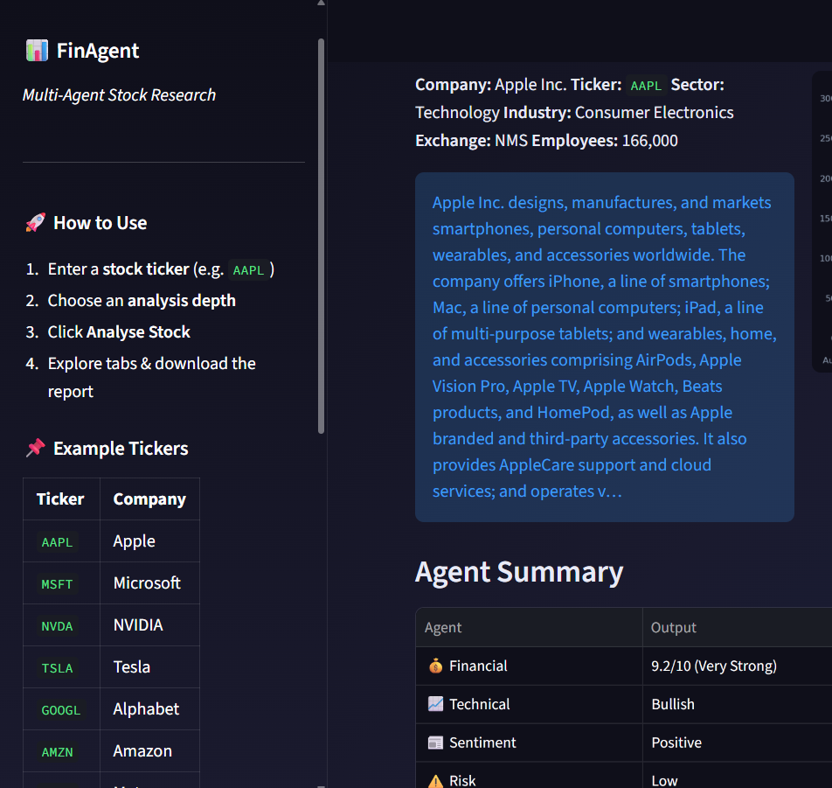
Streamlit Dashboard: Sidebar Functionality
APP GUIDANCE
Provides instructions and tips for navigating and utilizing the application effectively.
EXAMPLE TICKERS
Offers a list of sample stock tickers for users to explore and analyze.
RECOMMENDATION EXPLANATION
Details the criteria and logic behind the 'Buy', 'Hold', and 'Sell' recommendations.
EDUCATIONAL DISCLAIMER
Outlines the purpose of the dashboard as an educational tool and clarifies its limitations.
TECHNOLOGIES EMPLOYED
Lists the key technologies and libraries used in the development of the dashboard.
THE SIDEBAR SERVES AS A COMPREHENSIVE GUIDE AND INFORMATION HUB FOR USERS.

Slide 22
OUR APPROACH
Coding Standards & Scoring
EMPHASIS ON CODE QUALITY
Readable and well-commented code
Modular design principles
Robust error handling mechanisms
RULE-BASED SCORING SYSTEM
Evaluates financial health
Analyzes technical signals
Assesses risk factors

Slide 23




Decision Logic Example
Illustrates how agent outputs contribute to a 'Buy' recommendation
STRONG FINANCIALS
BULLISH TECHNICALS
POSITIVE SENTIMENT
LOW RISK
Positive indicators of company health and performance.
Chart patterns and indicators suggesting an upward price trend.
Favorable market or public perception of the asset.
Assessment indicating minimal potential for loss.
OUTCOME: 'BUY' RECOMMENDATION

Slide 24
README.md Highlights
Comprehensive Project Overview
PROJECT DESCRIPTION
Introduction to the project's purpose and goals.
FEATURES
Detailed list of the functionalities offered.
ARCHITECTURE
Explanation of the project's underlying structure and design.
INSTALLATION
Step-by-step guide for setting up the project.
USAGE INSTRUCTIONS
How to operate and utilize the project's features.
LIMITATIONS
Known constraints and boundaries of the project.
DISCLAIMER
Important legal and informational notices.
FUTURE IMPROVEMENTS
Planned enhancements and roadmap for the project.

Slide 25


Extra Features
SAMPLE REPORTS
ARCHITECTURE DIAGRAM
POTENTIAL ENHANCEMENTS
Access to comprehensive sample reports demonstrating data analysis and insights.
A detailed, text-based diagram outlining the system's architecture.
A forward-looking overview of planned features and future development directions.

Slide 26


Future Improvements
REAL-TIME NEWS APIS
LLM-BASED REASONING
RAG FOR EARNINGS REPORTS
Integrate live feeds for up-to-the- minute news relevant to investments.
Employ Large Language Models to analyze and interpret complex financial data.
Utilize Retrieval-Augmented Generation to extract insights from earnings call transcripts.
PORTFOLIO ANALYSIS
BACKTESTING STRATEGIES
Develop advanced tools for in-depth evaluation of investment portfolios.
Implement historical data analysis to test and refine investment strategies.

Slide 27

KEY TAKEAWAY
Conclusion
FinAgent offers a powerful, educational, and user-friendly platform for stock market analysis, showcasing the potential of multi-agent AI systems.
FINAGENT OFFERS A POWERFUL, EDUCATIONAL, AND USER-FRIENDLY PLATFORM FOR STOCK MARKET ANALYSIS, SHOWCASING THE POTENTIAL OF MULTI-AGENT AI SYSTEMS.

